Slide 1
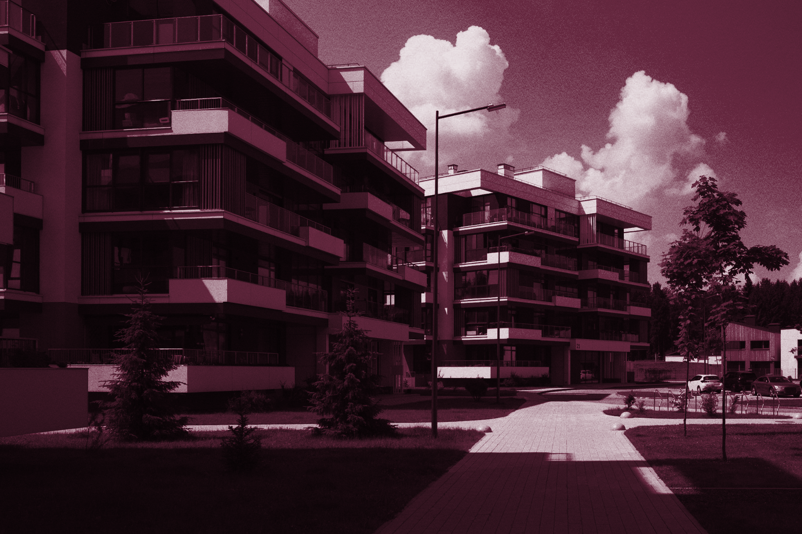
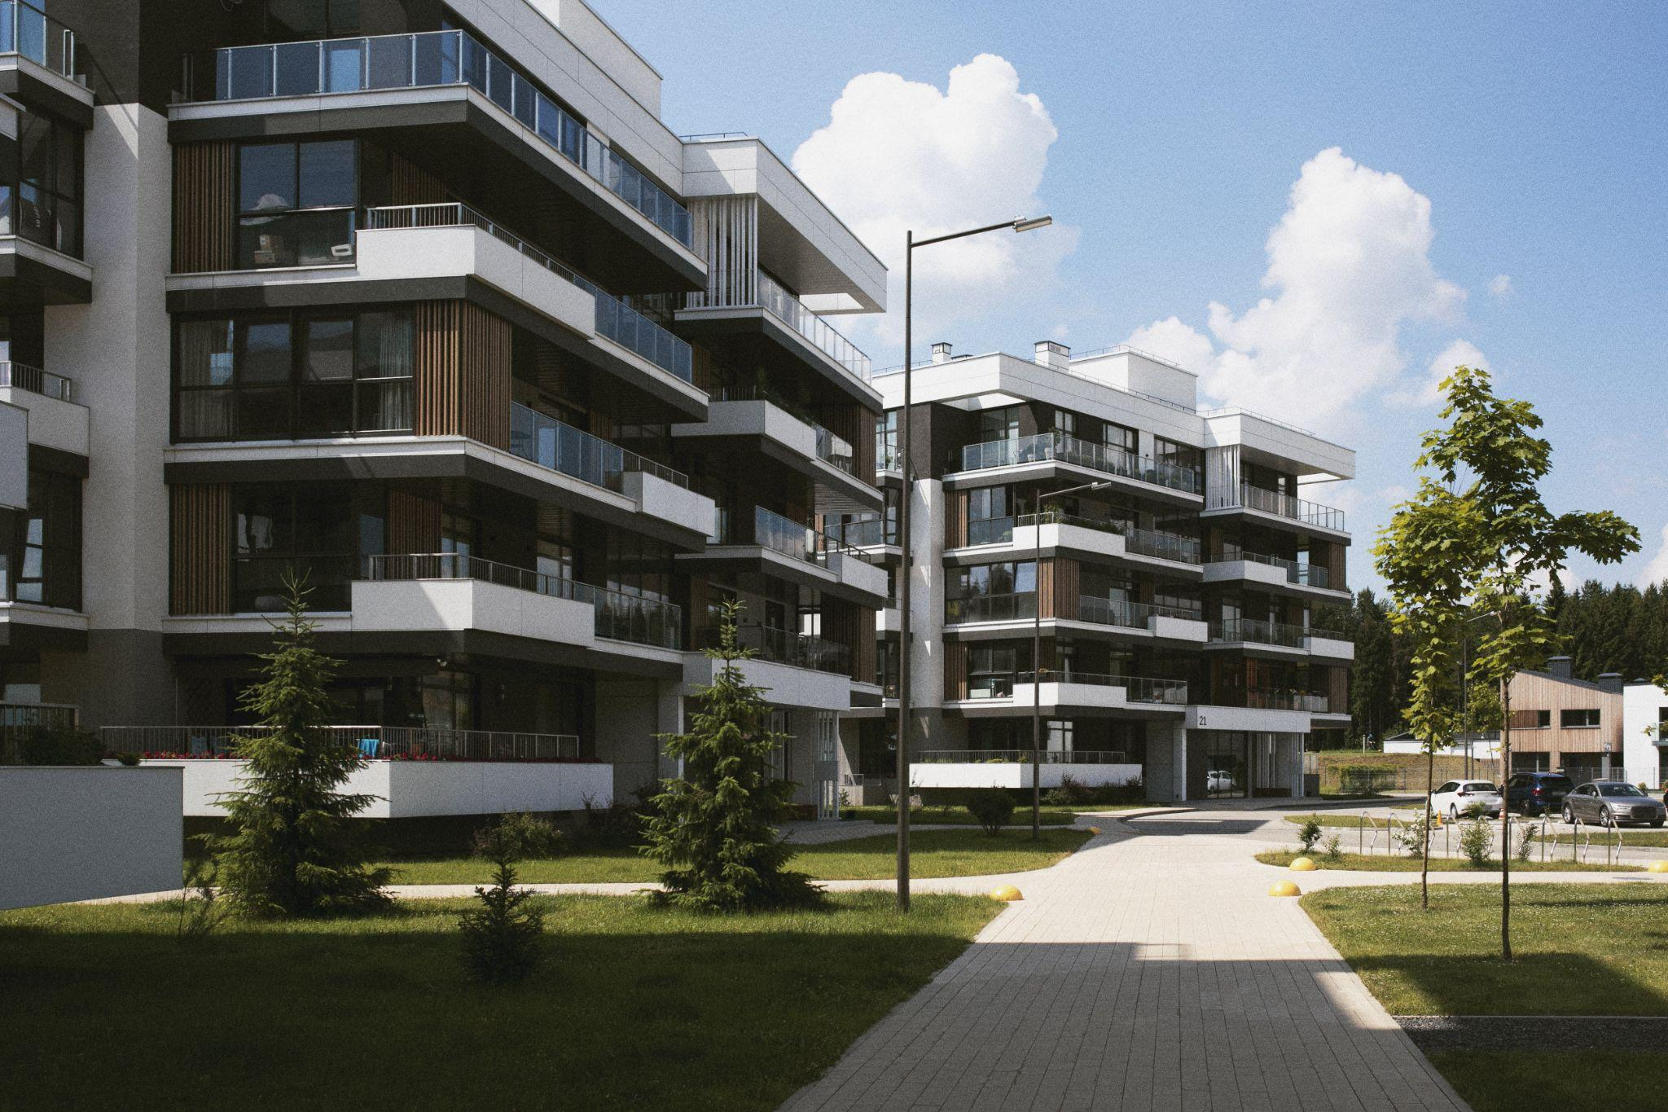
Analysis of Energy Efficiency in Buildings (part 2)

Slide 2
Introduction & Problem Statement
Our project aims to address energy inefficiency in residential buildings by leveraging machine learning to predict a building’s heating and cooling load based on its physical characteristics and configuration. We will be using a dataset that includes features such as the building’s relative compactness, surface area, wall area, roof area, overall height, orientation, and glazing area.
By accurately predicting a building’s heating and cooling load, we can identify which physical characteristics and configurations contribute most to energy consumption. This information can then be used to propose design modifications or operational changes to improve energy efficiency.
Through this project, we aim to demonstrate the potential of machine learning in contributing to cost savings, environmental sustainability, and the advancement of energy-efficient practices in the building industry. The code we will be demonstrating is a practical application of machine learning models, including Linear Regression, Decision Tree, and Random Forest, to achieve these objectives.
Our goal is to turn data into actionable insights that can drive energy efficiency in residential buildings. This not only has the potential to reduce costs for homeowners but also to contribute to broader efforts to reduce carbon emissions and combat climate change.

Slide 3
Goal of Each Selected Model
The goal of using these three machine learning models - Linear Regression, Decision Tree, and Random Forest - is to create models that can accurately predict the heating and cooling load of a building based on its physical characteristics and configuration. Here’s a brief overview of each model:
Linear Regression: This is a basic predictive analytics technique. It’s used to predict a dependent variable based on the values of one or more independent variables. The goal here is to find the line (or hyperplane in higher dimensions) that best fits the data.
Decision Tree: This algorithm creates a model that predicts the value of a target variable by learning simple decision rules inferred from the data features. It’s called a decision tree because it starts with a single box (or root), which then branches off into a number of solutions, just like a tree.
Random Forest: This is a type of ensemble learning method, where a group of weak models come together to form a strong model. In this case, the weak models are decision trees. Random forests create a set of decision trees from randomly selected subset of the training set and then aggregate the votes from different decision trees to decide the final class of the test object.

Slide 4
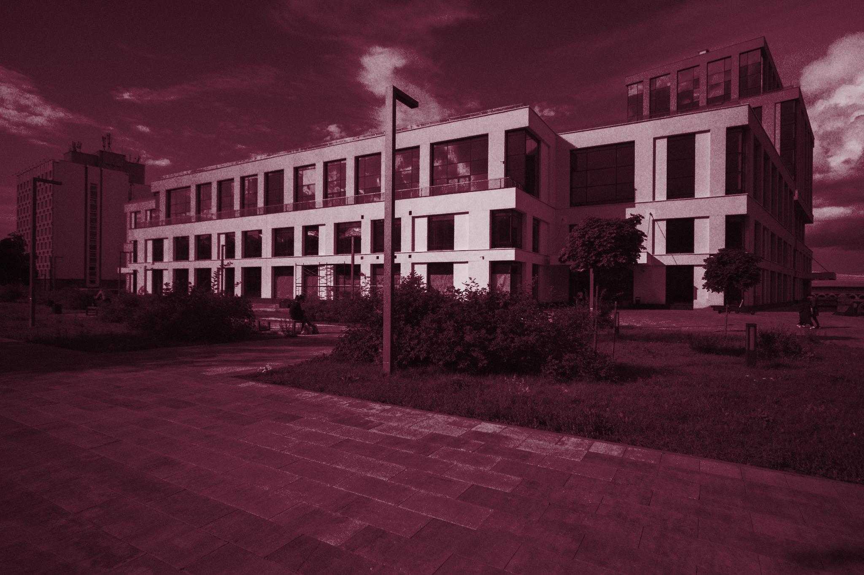
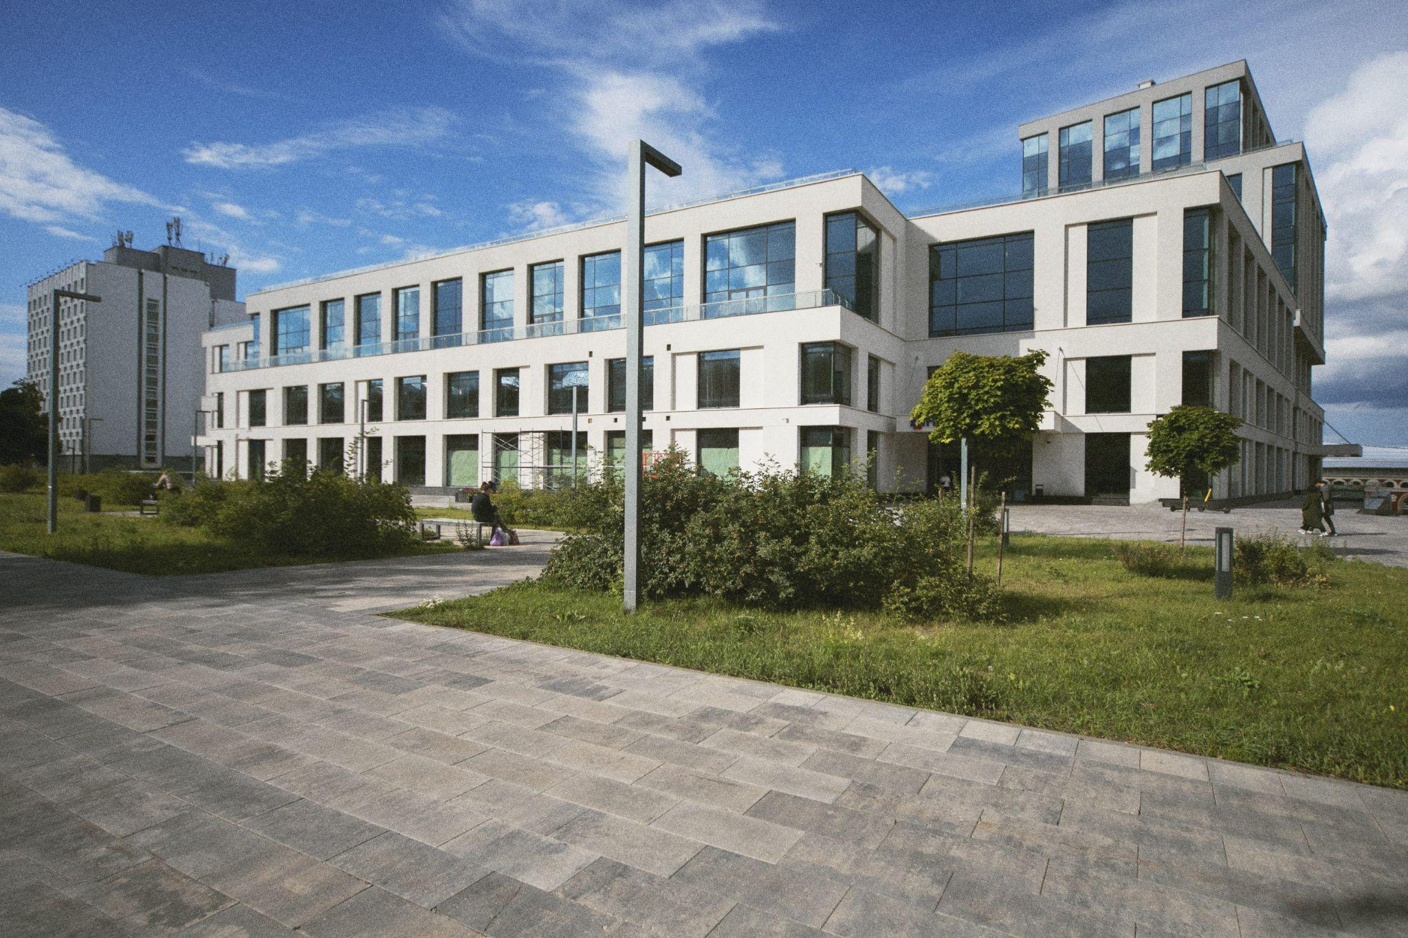
Areas of Focus of the 3 Models
Performance Comparison: By comparing the prediction results of the three models, you can determine which model performs best on our dataset in terms of accuracy, overfitting, or computational efficiency.
Feature Importance: Especially from the Random Forest model, you can get an understanding of which features are most important in predicting the heating and cooling load.
Insights for Energy Efficiency: Based on the feature importance and the model predictions, you can gain insights into what building characteristics lead to more or less energy efficiency.

Slide 5
Definition of Features or Predictors
Features are used to create a predictive model, and they provide the information that the model will base its predictions of the ‘Heating Load’ and ‘Cooling Load’ of buildings, which are the target variables or responses. They are:
Relative Compactness: This is the ratio of the volume of a building to the surface area of a building. A higher value indicates a more compact building.
Surface Area: This is the total area of all the surfaces (walls, roof, floor) of the building.
Wall Area: This is the total area of the building’s exterior walls.
Roof Area: This is the total area of the building’s roof.
Overall Height: This is the height of the building. It could be the number of floors or the actual height in meters or feet.
Orientation: This refers to the compass direction that the building faces (e.g., North, South, East, West).
Glazing Area: This is the total area of the building’s windows.
Glazing Area Distribution: This refers to how the windows (glazing area) are distributed across the building.
Heating Load: This is the amount of heat energy required to maintain a comfortable temperature in the building during the winter.

Slide 6
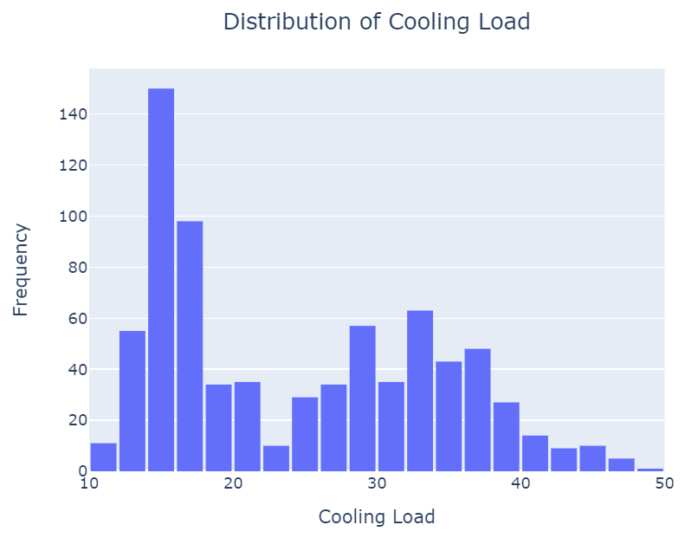
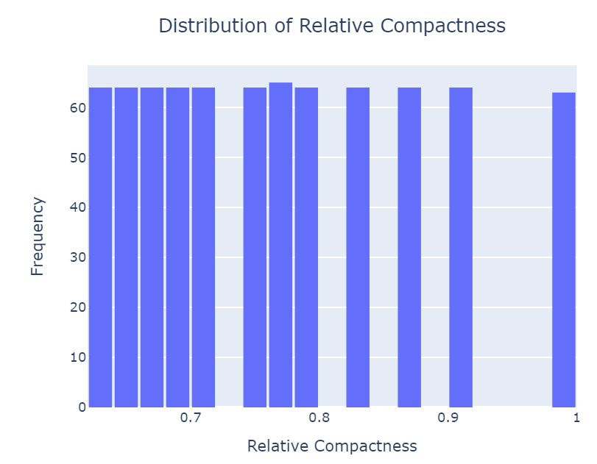
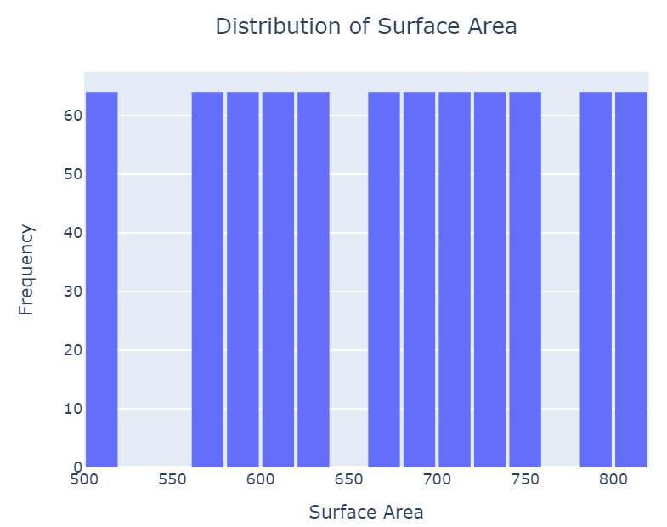
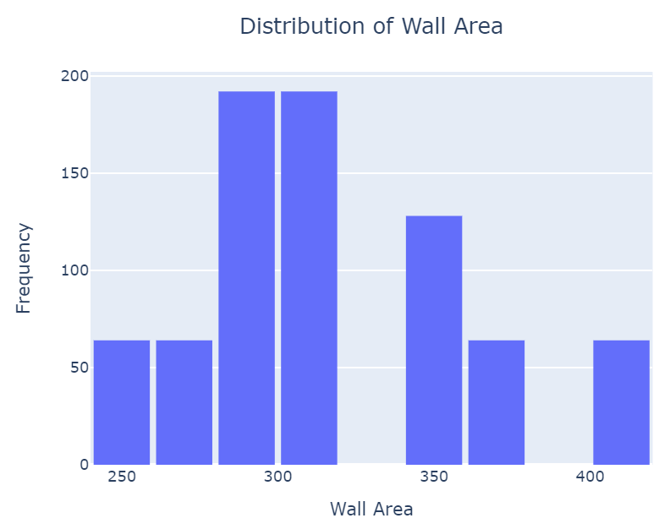
Univariate analysis Visualizations
Univariate analysis is an important step in the exploratory data analysis (EDA) phase of a machine learning project that involves analyzing each variable in the dataset independently to gain insights about its distribution, presence of outliers, and potential impact on the target variable.

Slide 7
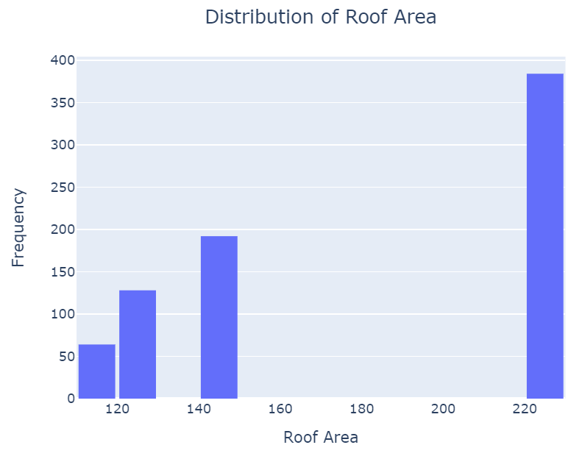
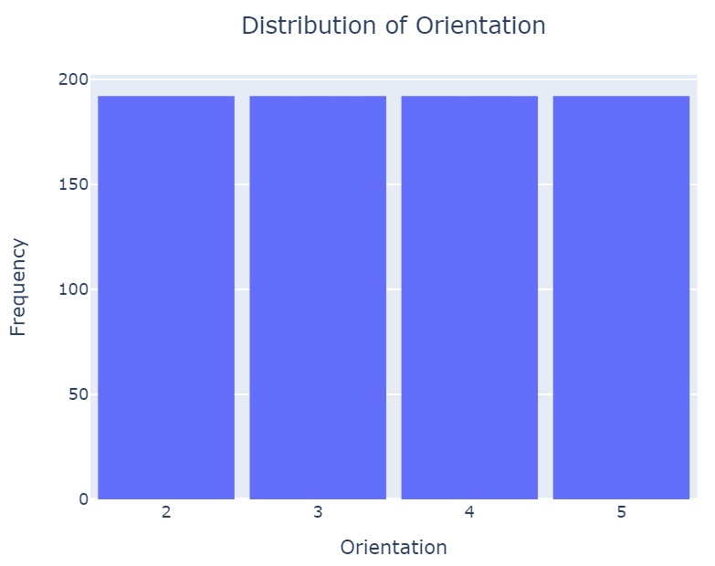
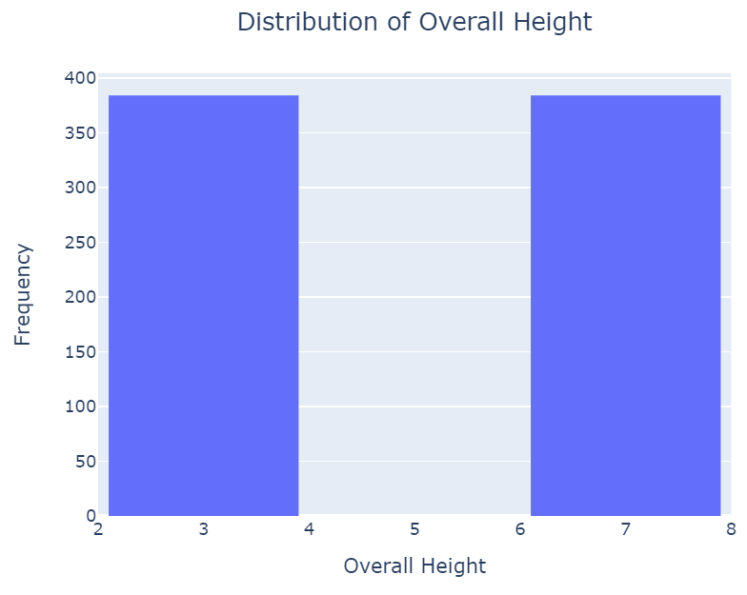
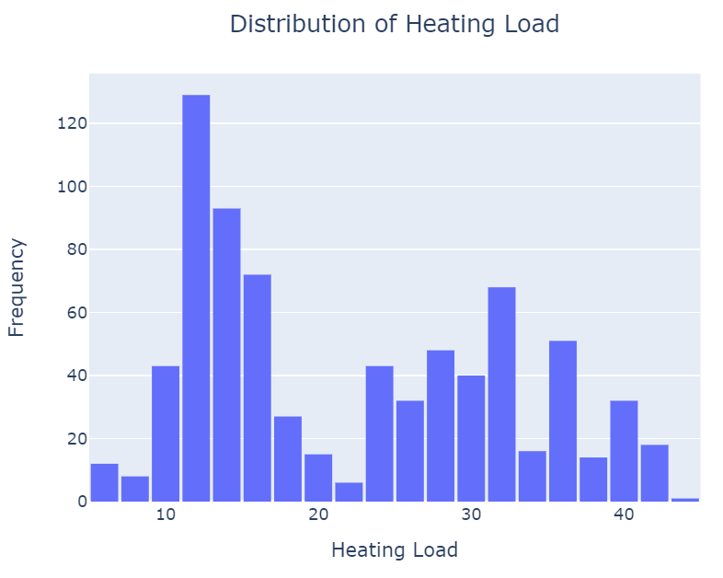
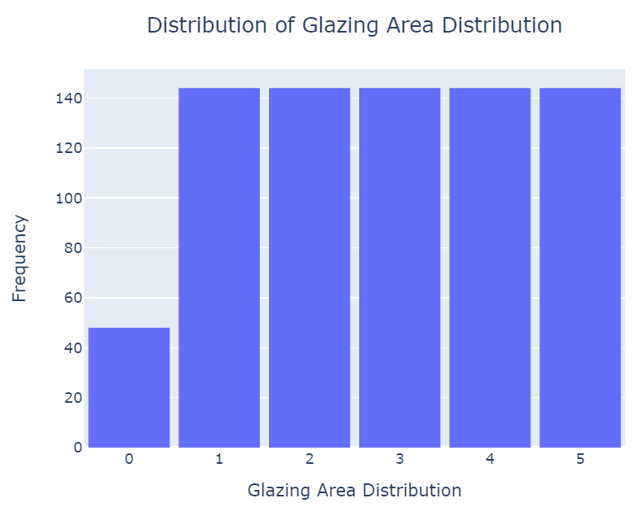
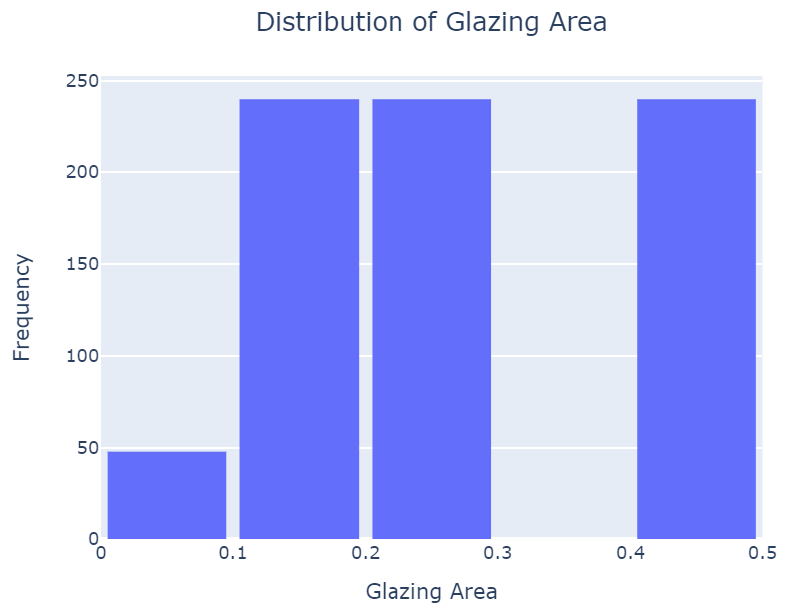
Univariate analysis Visualizations

Slide 8
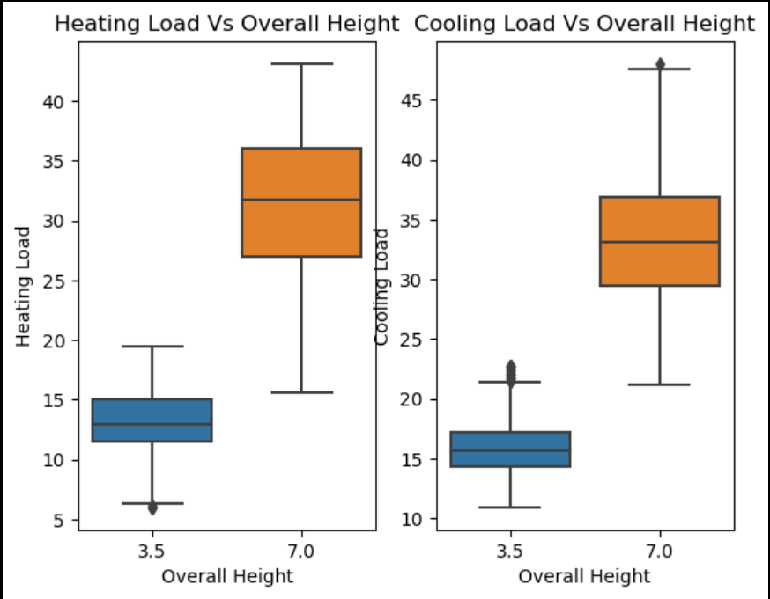
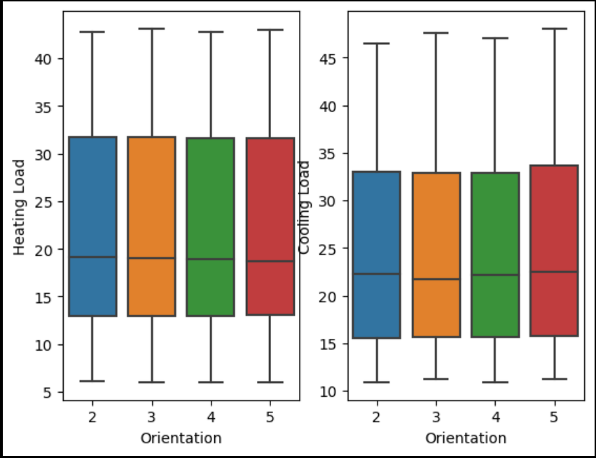
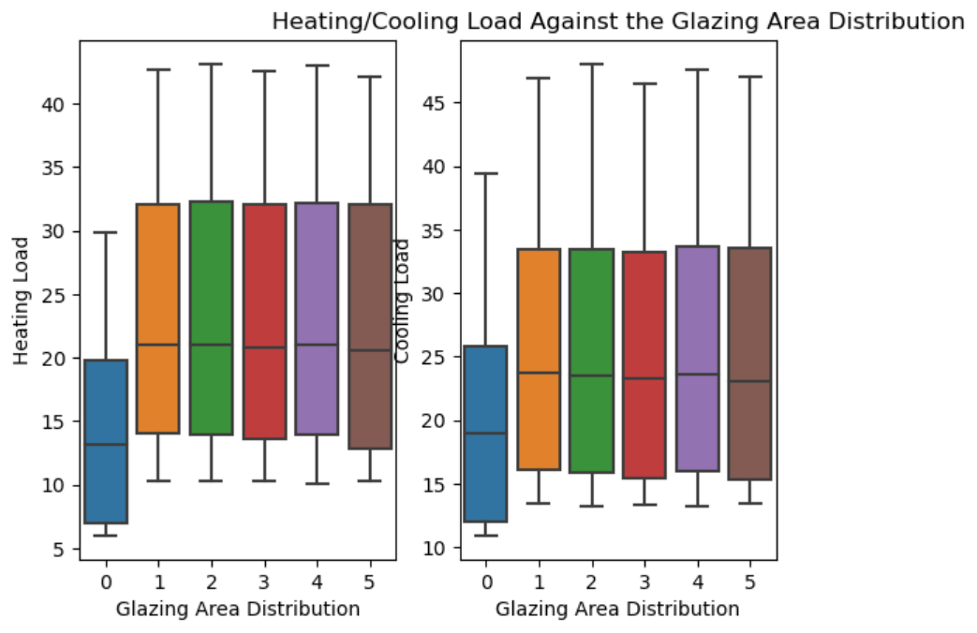
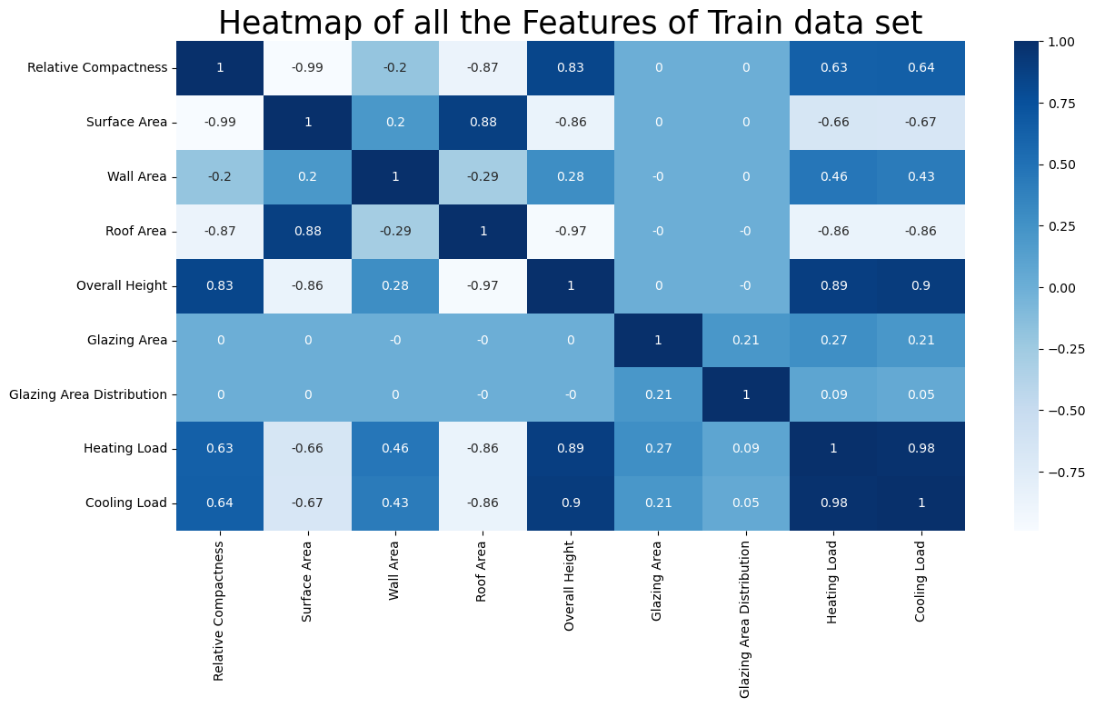
Multivariate analysis Visualizations
In machine learning, multivariate analysis can be used to understand the relationships between different features and their impact on the output variable. It can help in understanding complex behaviors, identifying important features, and creating more accurate predictive models.

Slide 9
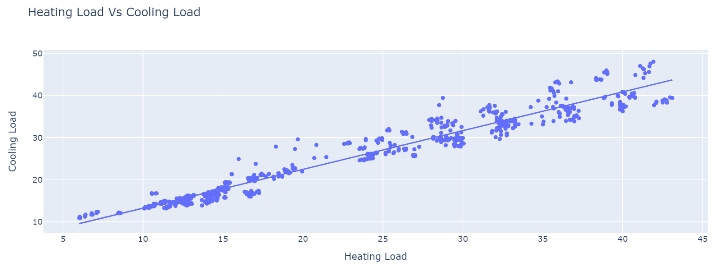
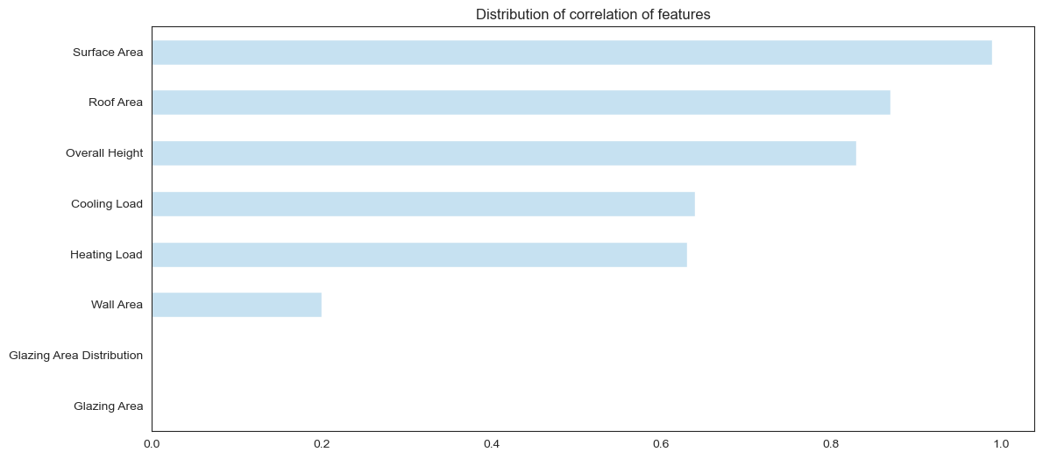
Multivariate analysis Visualizations

Slide 10
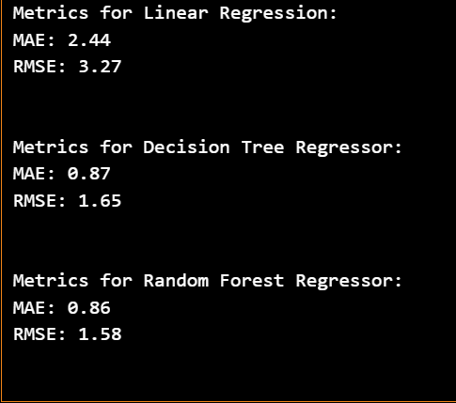
Performance Evaluation
In this part of our machine learning workflow, we evaluate the performance of our models. We use two key metrics for this purpose: Mean Absolute Error (MAE) and Root Mean Squared Error (RMSE).
Mean Absolute Error (MAE): This is the average of the absolute differences between the predicted and actual values. It gives an idea of how wrong the predictions were. The measure gives an equal weight to all errors, whether they are big or small. In MAE, all individual differences have equal weight.
Root Mean Squared Error (RMSE): This is the square root of the average of the squared differences between the predicted and actual values. RMSE gives a relatively high weight to large errors. This means the RMSE should be more useful when large errors are particularly undesirable.

Slide 11
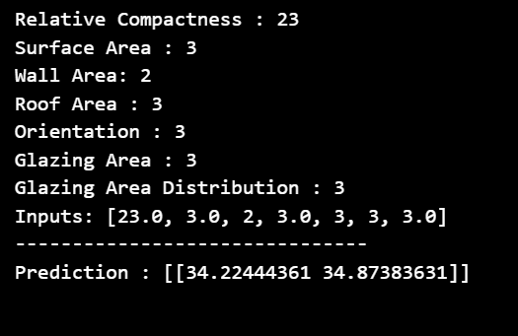
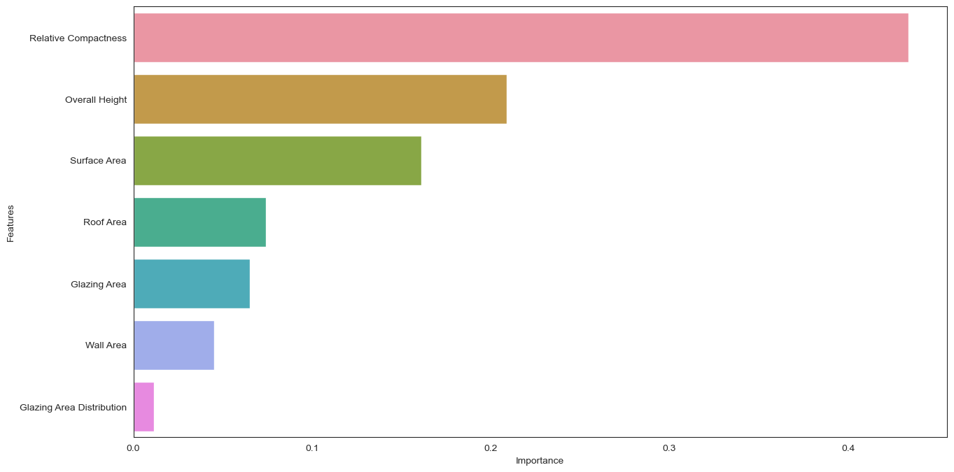
Performance Evaluation
We chose random forest model since it has the smallest MAE and RMSE. Looking at the results of the diagram we can see that the most important feature in our random forest model is relative compactness.

Slide 12
Recommendations (Insights)
1. Surface Area:
- Minimize External Surface Area: Design the building with a compact shape to reduce the external surface area, which helps in minimizing heat loss or gain.
2. Wall Area:
- High Thermal Insulation: Use high-quality insulation materials for walls to reduce heat transfer through the building envelope.
- Optimal Window-to-Wall Ratio: Limit the amount of window area to minimize heat loss or gain. Balance natural light and energy efficiency.
3. Roof Area:
- Cool Roofing: Choose reflective roofing materials to reduce heat absorption and minimize the cooling load.
- Insulation: Insulate the roof adequately to prevent heat transfer between the interior and exterior.
4. Overall Height:
- Low-rise Design: In general, lower buildings have less surface area, reducing the overall energy requirements.

Slide 13
Recommendations (Insights)
5. Orientation:
- Passive Solar Design: Align the building to maximize or minimize exposure to the sun, depending on the climate. Use passive solar design principles to optimize natural heating and cooling.
6. Glazing Area:
- High-Performance Windows: Invest in energy-efficient windows with low U-values and high solar heat gain coefficients (SHGC) to minimize heat loss and gain.
- Use of Double Glazing: Double or triple glazing can enhance insulation properties and reduce heat transfer.
7. Glazing Area Distribution:
- Strategic Placement: Concentrate windows on the south side for passive solar heating while minimizing exposure on the east and west sides to control heat gain.
8. Heating Load:
- Efficient Heating Systems: Use high-efficiency heating systems, such as condensing boilers or heat pumps, to reduce energy consumption.
- Zoning: Implement zoning systems to heat only occupied spaces, optimizing energy use.

Slide 14
Recommendations (Insights)
9. Cooling Load:
- Shading: Use external shading devices like awnings, shades, or vegetation to reduce direct sunlight and control cooling loads.
- Natural Ventilation: Incorporate natural ventilation strategies to minimize the need for mechanical cooling.

